Slide 1
Agentic Multi-Source Log Correlation for Incident Analysis
Jason Shao, Tahira Smith, Siddarth Kumar, Omar Aldera

Slide 2
Overview
When something goes wrong in a computer system, the problem usually doesn’t show up in just one place
Authentication services, host processes, network activity, and infrastructure metrics
Looking at logs separately makes it hard to understand what really happened
Objective: Build a system of AI agents
Analyze specific log sources
A coordinator looks for connections across different logs
Output possible explanations for the incident
Notes:
Jason

Slide 3
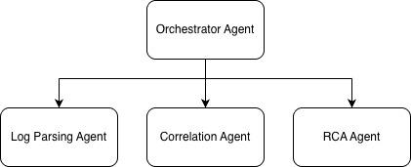
AI Agent Design
Orchestrator = decides which sub-agent runs
Parsing Agent = extracts structure
Correlation Agent = finds related events
Root Cause Agent = explains failure
Notes:
Jason

Slide 4
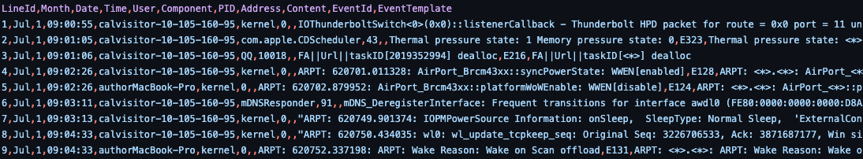
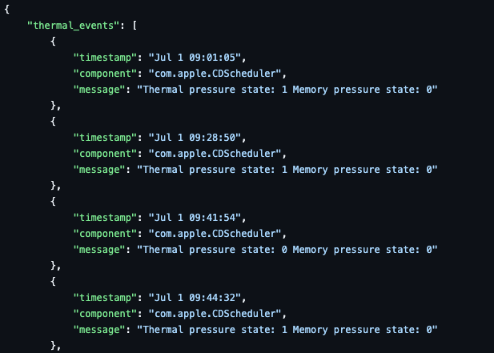
Data Model
Our AI agents do not operate on raw text
Logs originate from different systems (application, database, infrastructure)
Each source uses different timestamp formats and severity levels
Raw logs are inconsistent and difficult to correlate
AI agents require structured, standardized input for reliable reasoning
Parse raw logs into structured log format JSON and normalize
Notes:
Jason

Slide 5
Data Selection
OpenStack Log Dataset inside LogHub Repository (https://github.com/logpai/loghub/tree/master/OpenStack)
Logs from a single cloud system
Includes: Compute (Nova), Networking (Neutron), Storage (Cinder), Identity (Keystone)
Real cloud deployment behavior
Ideal for multi-service log correlation
Notes:
Jason

Slide 6
Inference Layer and Model Selection
The model must be able to handle:-
Multi-step reasoning
Pattern recognition across different sources
Hypothesis generation with confidence
Heuristics for choosing a model:-
Reasoning quality
Context window
Determinism
Cost
Using Ollama and llama 3.1:8b to start off with

Slide 7
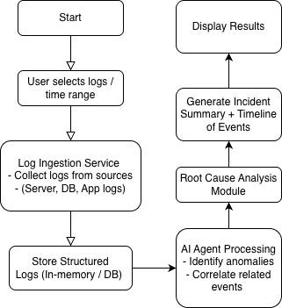
System Workflow
Notes:
Jason

Slide 8
Metrics and Evaluation
Correlation Accuracy Metrics
Precision - % of correlated events that are truly related
Recall - % of truly related events successfully identified
F1 Score - Balance between precision and recall
Comparison against labeled incident datasets (if available)
Root Cause Analysis (RCA) Evaluation
Exact match with known root cause (if ground truth exists)
Consistency across multiple runs

Slide 9
Challenges
Noisy logs containing irrelevant events
LLM hallucination when inferring causal relationships
Maintaining low latency for near real-time analysis
Measuring correlation accuracy objectively
Grounding errors (hallucinated timestamps / line numbers)
RAG limitations for large datasets

Slide 10
Goals for the Next Demo
Real log ingestion with multiple log sources
Specialized Source Agents (network, authentication, host etc.)
Add Retrieval Layer
Basic parsing
Log normalization
Simple LLM summary

Slide 11
Quiz Question
How does our system process raw logs before sending them to the correlation agent?

